Slide 1

Social Media Trends Analysis
Prepared By: Harshit Pandey and Geetha
Mentor: Valli Natarajan

Slide 2
Introduction
The “Viral Social Media Trends Analysis” project is developed using Microsoft Excel to analyze social media performance data from different platforms. The main purpose of this project is to identify trending content, engagement patterns, regional performance, and audience interaction through data visualization and dashboard analysis.
In this project, raw social media data was cleaned, organized, and analyzed using various Excel features such as Pivot Tables, Charts, Conditional Formatting, Filters, Data Cleaning, and Dashboard Design. The dashboard provides insights into likes, shares, comments, engagement rates, hashtags, and platform-wise performance.
This project helps in understanding how social media trends impact audience engagement and how businesses or content creators can improve their online performance by using data-driven decisions.
Social Media Trend Analysis Project

Slide 3
Objectives
To analyze viral social media trends using Excel.
To study audience engagement across different platforms.
To identify top-performing hashtags and content types.
To compare regional and monthly engagement trends.
To create an interactive dashboard for easy data visualization.
To perform data cleaning and remove inconsistencies from the dataset.
Social Media Trend Analysis Project

Slide 4
Dataset Overview
Dataset includes:
Post_Date
• Platform
• Likes
• Shares
• Comments
• Views
• Engagement Rate
• Region
Social Media Trend Analysis Project

Slide 5
Tools & Technologies
Microsoft Excel
Pivot Tables
Pivot Charts
Slicers
Conditional Formatting
Data Cleaning Techniques
Dashboard Design
Formulas and Functions
Social Media Trend Analysis Project

Slide 6
Data Cleaning Process
Handled missing values, duplicate records, formatting issues, and prepared the dataset for analysis.
Social Media Trend Analysis Project

Slide 7
Platform Analysis
Compared social media platforms such as Instagram, YouTube, TikTok, and Twitter.
Platform | Average of Views
Instagram | 2527459
TikTok | 2146542
Twitter | 2758539
YouTube | 29722
Grand Total | 2479652
Social Media Trend Analysis Project

Slide 8
Content Type Analysis
Analyzed performance of videos, reels, images, and other content formats.
Content Type | Average of Engagement Rate
Live Stream | 18.95%
Post | 19.92%
Reel | 16.24%
Shorts | 19.58%
Tweet | 18.92%
Video | 18.68%
Grand Total | 0.187391682
Social Media Trend Analysis Project

Slide 9
Hashtag Trend Analysis
Identified trending hashtags and their impact on audience engagement.
Social Media Trend Analysis Project

Slide 10
Regional Analysis
Compared engagement trends across different regions and audience groups.
Region | Sum of Views
Australia | 410682697
Brazil | 432760531
Canada | 426970294
Germany | 397394102
India | 389117554
Japan | 340846408
UK | 464936524
USA | 493033543
Grand Total | 3355741653
Social Media Trend Analysis Project

Slide 11
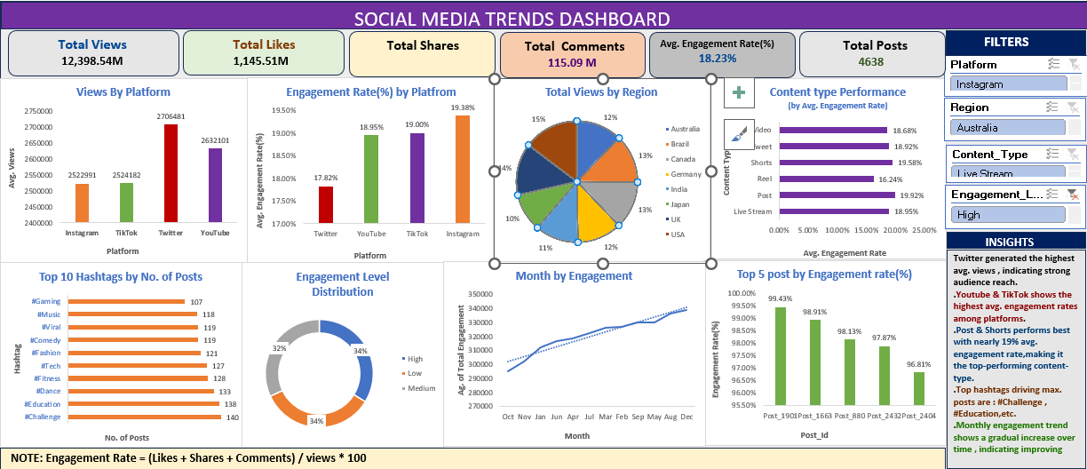

Slide 12
Key Findings
The analysis showed that Twitter had the highest average engagement rate among all social media platforms.
TikTok and Twitter generated higher average views compared to other platforms, showing stronger audience reach.
Video and Shorts content performed better in terms of total engagement than other content types.
Trending hashtags such as #Challenge and #Education received high audience interaction and views.
Certain regions showed significantly higher likes and engagement, indicating that audience behavior changes by location.
Monthly analysis revealed that engagement levels were not constant throughout the year and varied from month to month.

Slide 13
Project Outcomes
Easy comparison of engagement metrics across regions and months.
Better understanding of social media engagement trends.
Identification of high-performing hashtags and platforms.
Improved analytical and dashboard creation skills in Excel.
Enhanced ability to clean and visualize real-world datasets.

Slide 14
Questionnaire
General Questions
What is the main aim of this project?
Why is social media trend analysis important?
Which dataset was used in this project?
What are the key performance indicators analyzed?
What is the importance of dashboards in data analysis?
Excel Related Questions
Which Excel tools were used in this project?
What is a Pivot Table and why is it used?
How did you clean the dataset?
What is conditional formatting?
What is the purpose of slicers in dashboards?
Which formulas or functions were used?
How did you calculate engagement rate?

Slide 15
Conclusion
The Viral Social Media Trends Analysis project demonstrates how Microsoft Excel can be used effectively for data analysis and dashboard creation. The project provides valuable insights into audience engagement, trending hashtags, and platform performance. It also improves analytical thinking and practical Excel skills, making it useful for academic learning as well as real-world business applications.
Social Media Trend Analysis Project

